Slide 1
Quality control for scRNAseq data
Orr Ashenberg, Jacques Serizay, Fabrício Almeida-Silva
November, 2024
Notes:
₁

Slide 2
Lecture topics
Interacting with Seurat objects
Quality control, normalization, and feature selection starting from raw count or expression matrices
Next step will be dimensionality reduction, clustering, and visualization
Notes:
Add a biological background
Mention SinglkeCellExperimemnt

Slide 3
Determining cell type, state, and function
Quality control
Normalization
Feature selection
Dimensional reduction
Cell-cell distances
Unsupervised clustering
Kiselev C. at al. (2019) Nature Reviews Genetics. 20: 273-282.

Slide 4
Interacting with Seurat objects
Seurat object is used for to store 10x data and perform analysis
Count matrices for different assays are stored (gene expression, protein expression, chromatin accessibility, etc…)
Counts are stored as: counts (raw), data (normalized), scaled data (centered and scaled) in sparse matrices when possible
Metadata describes individual cells and genes
Functions for analysis (quality control, normalization, feature selection, dimensional reduction, cell-cell distances, unsupervised clustering)
https://github.com/satijalab/seurat/wiki
https://satijalab.org/seurat/essential_commands.html

Slide 5
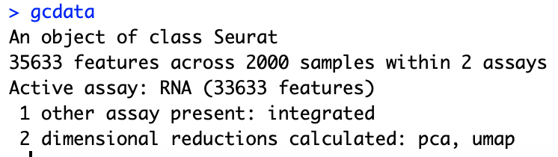
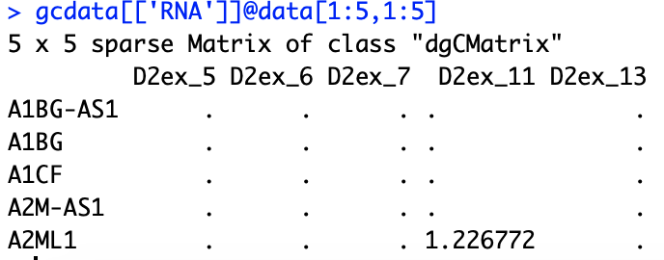
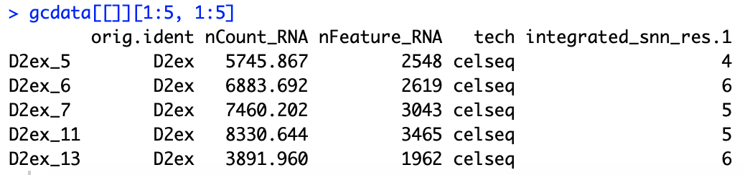
Interacting with Seurat objects
Seurat object
Accessing count slot from RNA assay
Accessing cell metadata
Running analysis function

Slide 6
Loading data into a Seurat object
gcdata <- CreateSeuratObject(counts = celseq.data)
counts matrix

Slide 7
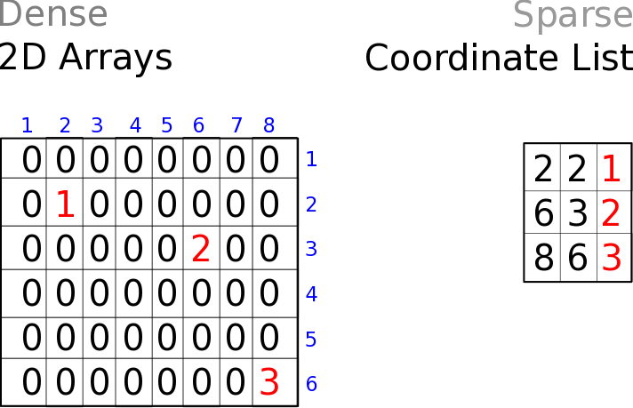
Storing counts data in dense vs sparse format
cells
genes
Dense matrices
Sparse matrices

Slide 8
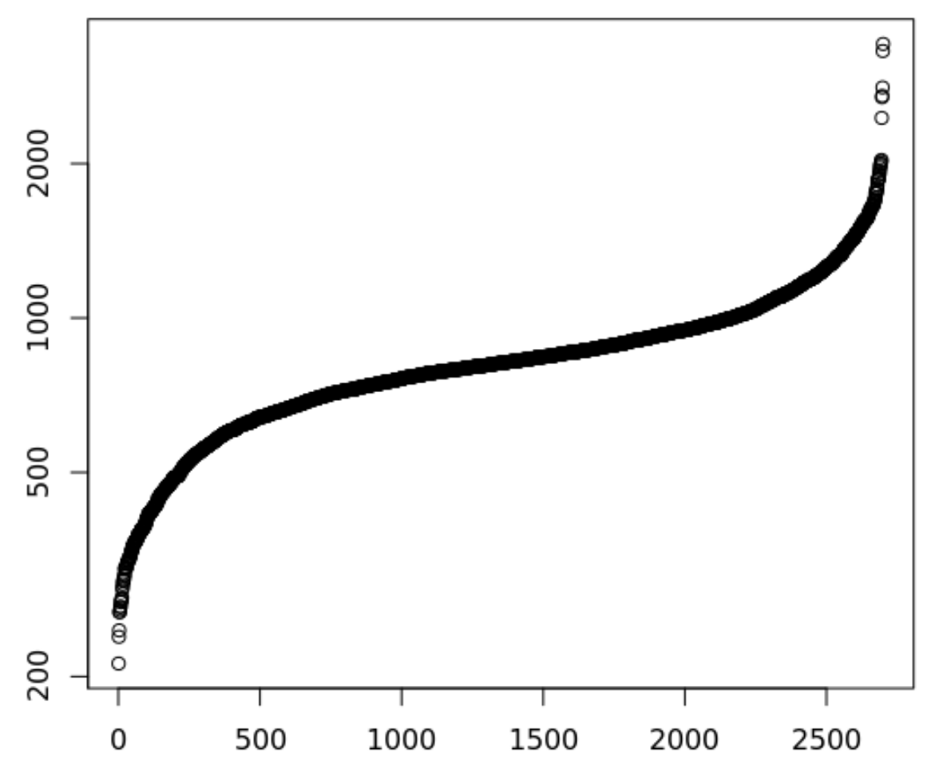
There are many quality control filters for genes and cells
Genes detected per cell (ordered)
Complexity =
Number of genes detected in a cell
Complexity
Complexity
Cell
Notes:
Filtering both ends. Lower: Failed libraries? Higher: Doublets?
Outlier cells are not just measured by complexity
•Percent Reads Mapping
•Percent Mitochondrial Reads
•Presence of marker genes
•Intergenic/ exonic rate
•5' or 3' bias
•other metadata …
•Useful Tools
Picard Tools and RNASeQC

Slide 9
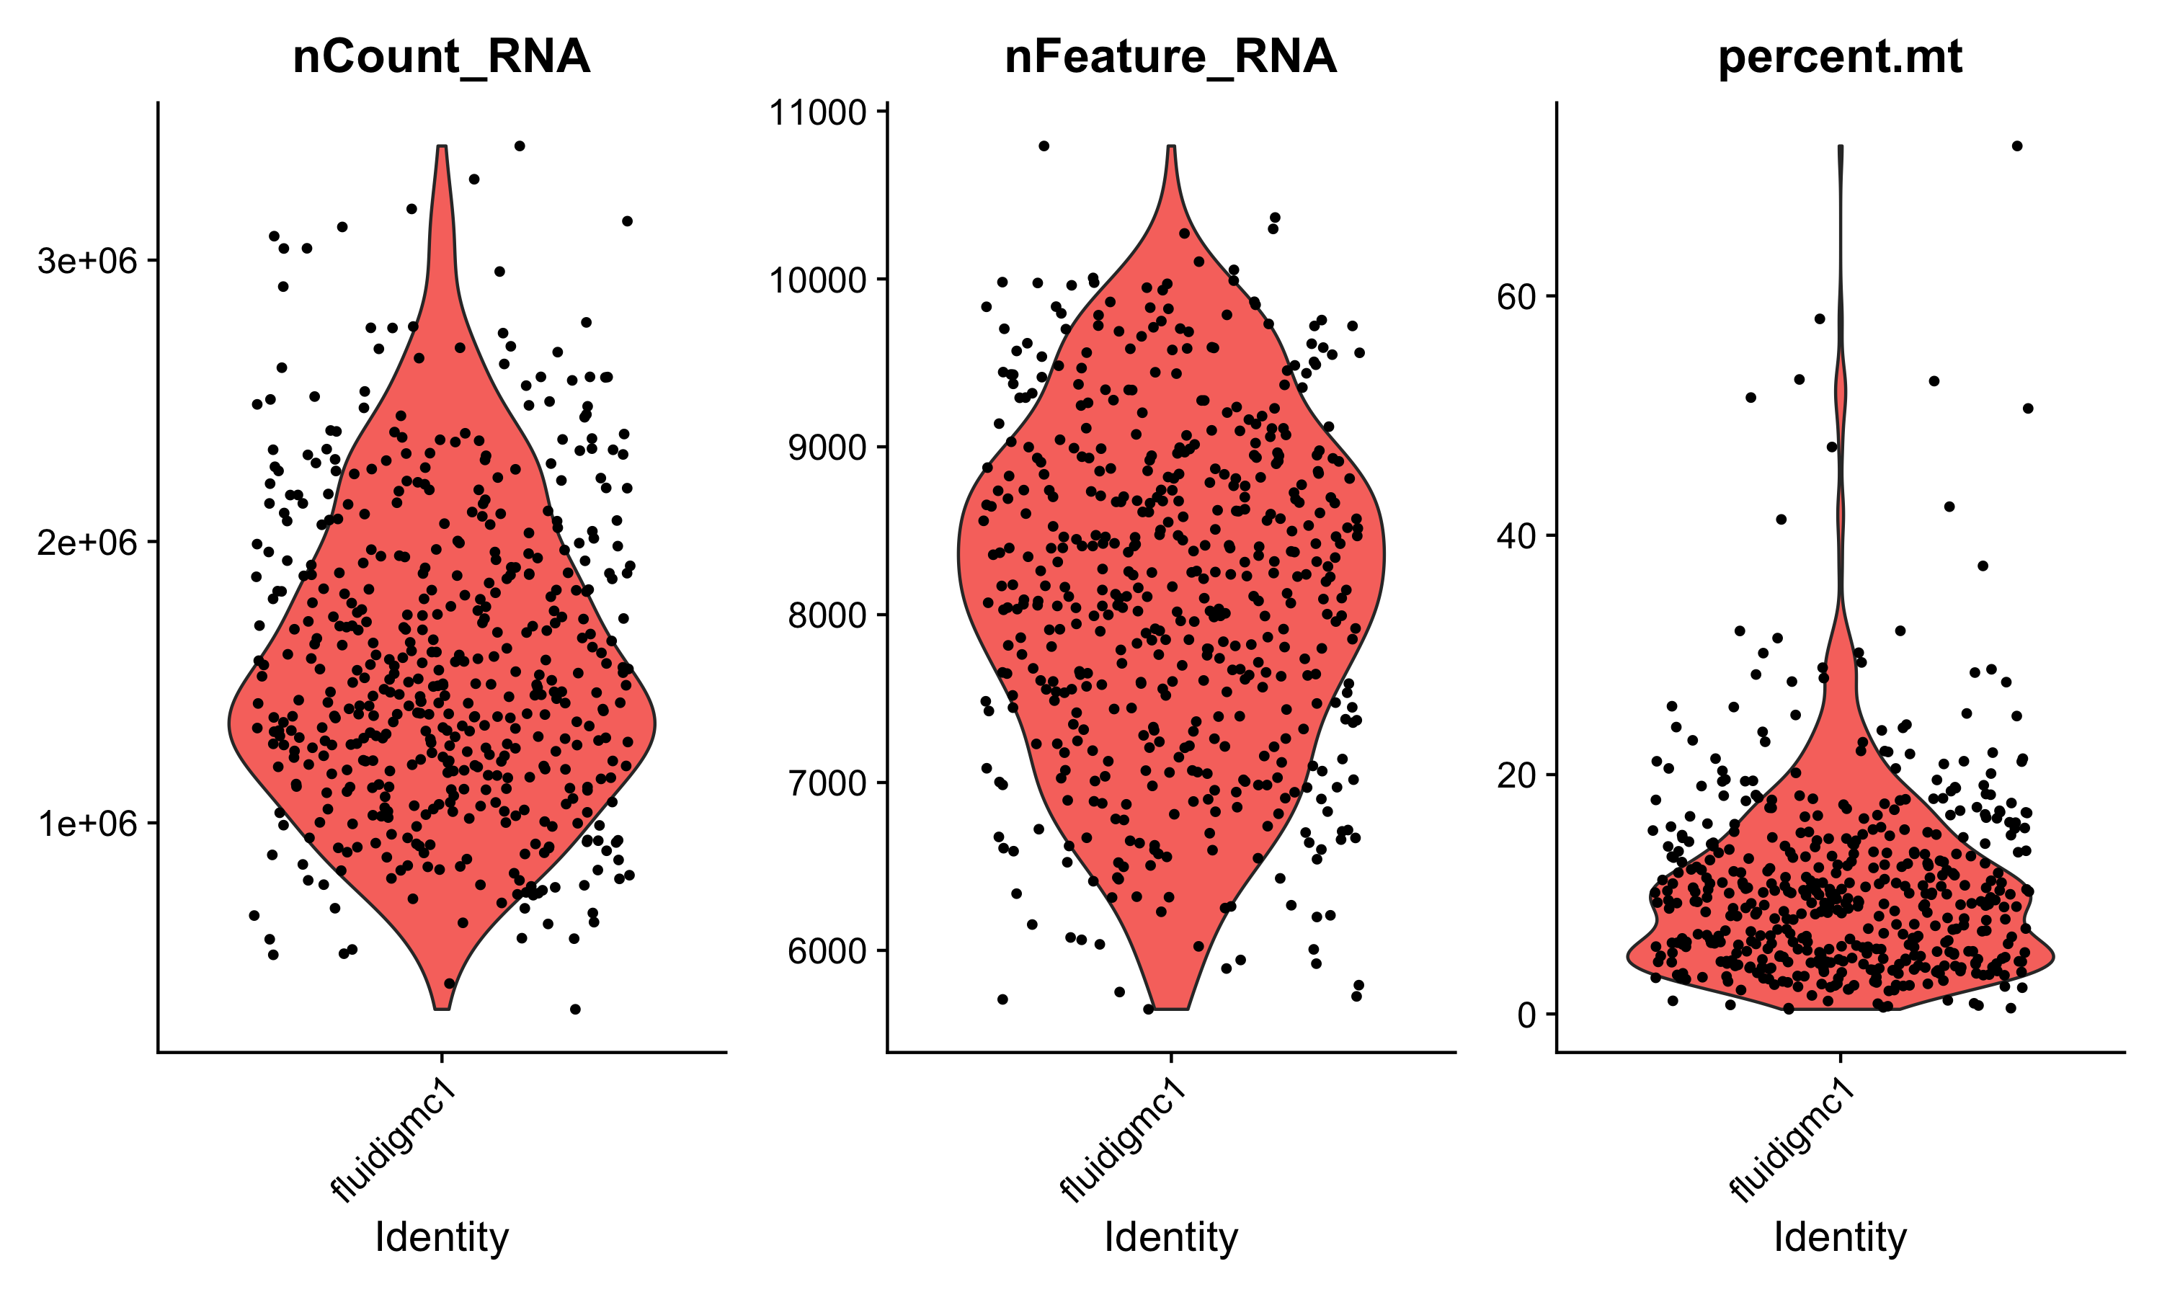
There are many quality control filters for genes and cells
We filter cells based on technical or biological parameters.
# reads or UMIs detected in a cell
# genes detected in a cell
% mito expression in a cell

Slide 10
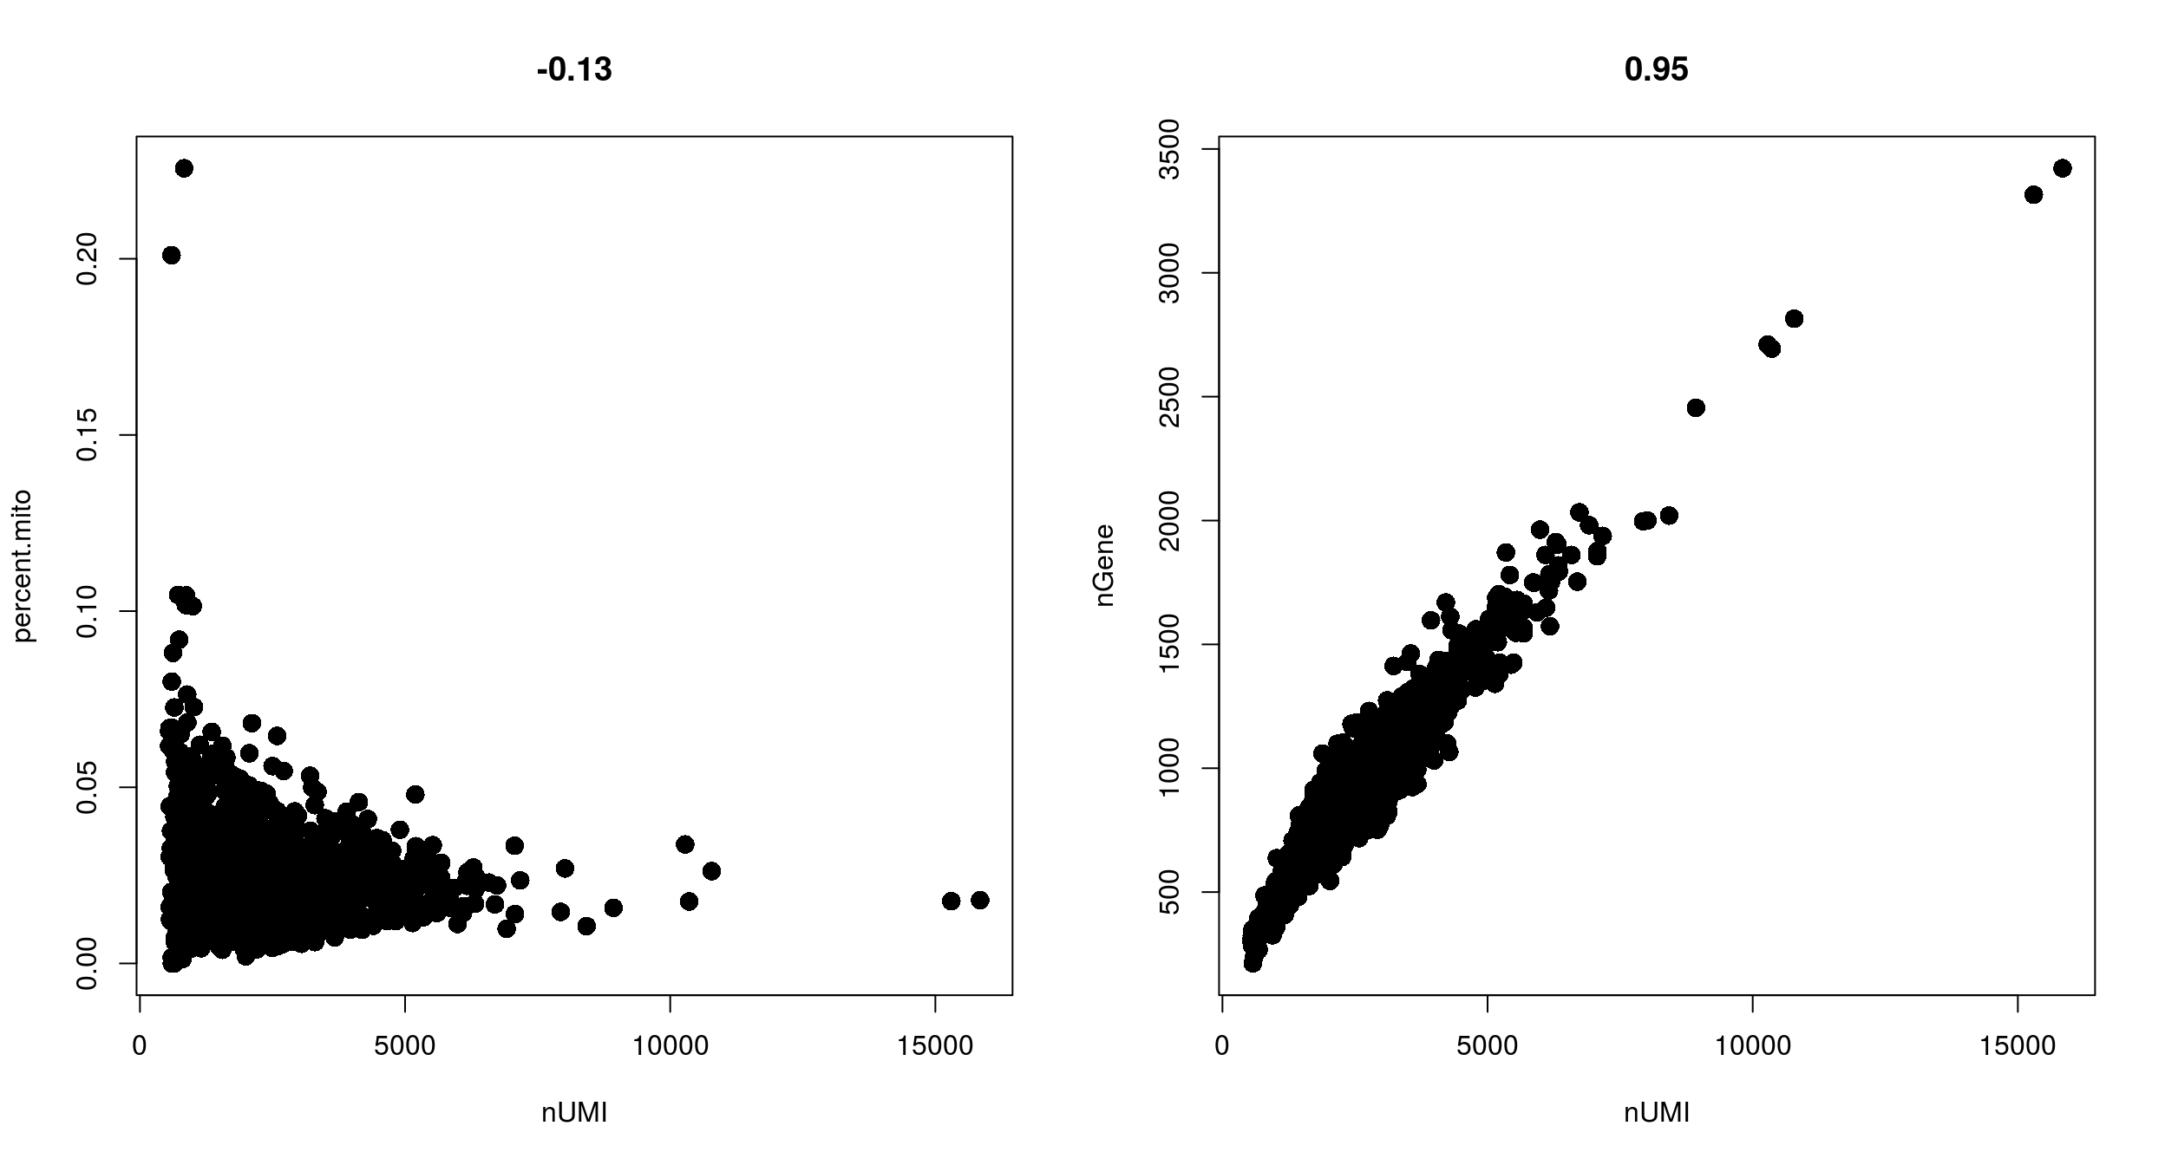
Filtering with combinations of quality control filters
Low nUMI and high % mitochondrial- Cells captured but lost a lot of the mRNA, and the mitochondrial genes were protected and retained
High nUMI & low nGene ratio – low quality library or capture rate
nGene
% mito
High nUMI & high nGene – doublets
nUMI
nUMI
Notes:
Cells got raptured and lost a lot of the mRNA, but the mitochondrial genes are protected (0.1, 10000)
Add black dot on the right

Slide 11
Appropriate quality control filters vary with platform and
cell types
Different platforms set different expectations
e.g. Smart-Seq2 often yields more genes detected per cell than 10x Chromium.
Different cell types set different expectations
Immune cells normally have fewer genes detected per cell than non-immune cells
Malignant cells normally have more genes detected per cell than non-malignant cells
Notes:
Malignant cells are more transcriptional active

Slide 12
A classifier for low-quality cells
“The pipeline takes advantage of a highly-curated set of generic features that are incorporated into a machine learning algorithm to identify low quality cells.”
Ilicic T. et al. (2016) Genome Biology 17: 29.
Notes:
Malignant cells are more transcriptional active

Slide 13
A classifier for low-quality cells
SVM feature weights
What are caveats to this approach?
Ilicic T. et al. (2016) Genome Biology 17: 29.
Notes:
Malignant cells are more transcriptional active

Slide 14

Other quality control filters for genes and cells
Doublets
number of genes
number of UMIs
percentage of mitochondrial gene expression
Ambient RNA and empty droplets
number of genes
number of UMIs
percentage of mitochondrial gene expression
Barcode swapping
Notes:
Sqyuishy wave

Slide 15
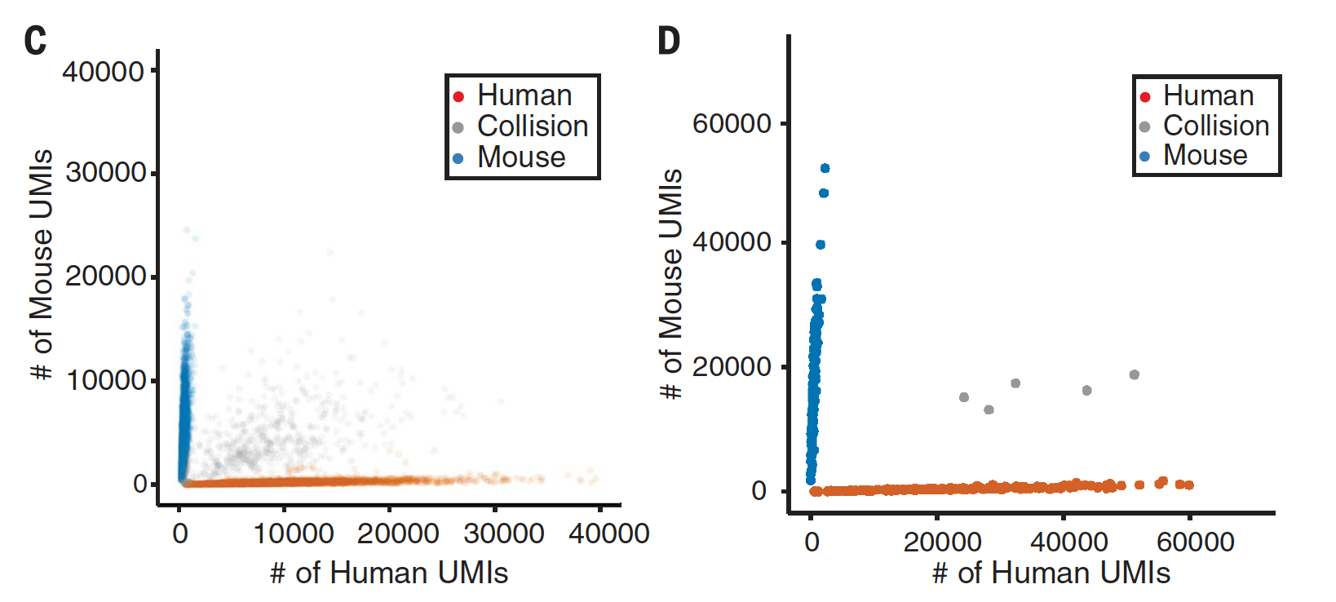
Cell doublets can be misleading
Because of the setup, it is possible that two or more cells can enter the same droplet.
Studies estimate doublet frequency through a “mixed-species” experiment
~14% doublets
<2 % doublets
The doublet frequency is positively correlated with throughput
Slide courtesy of Karthik Shekhar

Slide 16
Detecting cell doublets with Scrublet
Scrublet (Single-Cell Remover of Doublets)
Wolock, Lopez, Klein. Cell Systems 8.4 (2019): 281-291.
Notes:
Finally, we do another step of processing to distinguish droplets that contain a single cell from those droplets that contain two or more cells. The latter are not useful, especially as one of our main goals is to identify cell-type specific eQTLs and these doublets do not represent a real cell type.

Slide 17
Detecting cell doublets with Scrublet
Wolock, Lopez, Klein. Cell Systems 8.4 (2019): 281-291.

Slide 18
Detecting empty drops containing ambient RNA – manual
Look for transcripts expressed in unexpected cell types and remove those genes from all subsequent analysis
e.g. hemoglobin expressed in a T cell

Slide 19
Detecting empty drops containing ambient RNA – automatic
EmptyDrops (distinguish cells from empty droplets)
Cells ranked by total
unique molecular identifiers (UMI)
10000
1000
100
10
Cell encapsulated in droplet
Total UMI detected per cell
Mixture
Ambient RNA encapsulated in droplet
Lun, A.T.L. et al. Genome Biol (2019). 20, 63.

Slide 20
Detecting barcode swapping in multiplexed samples
“Barcode swapping is a phenomenon that occurs upon multiplexing samples on the Illumina 4000 sequencer. Molecules from one sample are incorrectly labelled with sample barcodes from another sample, resulting in their misassignment upon demultiplexing.”
”Specifically, we considered molecules across multiplexed samples that contain the same combination of unique molecular identifier, cell barcode, and aligned gene.”
Griffiths, J. A. et al. Nature Communications (2018).9: 2667.
https://bioconductor.org/packages/devel/bioc/vignettes/DropletUtils/inst/doc/DropletUtils.html#removing-the-effect-of-barcode-swapping

Slide 21
Tool to detect empty drops, correct ambient RNA and barcode swapping
CellBender remove ambient background and barcode swapping via deep learning
Detecting empty droplets
Correcting ambient RNA and barcode swapping
Fleming et al. bioRxiv (2019)

Slide 22
Determining cell type, state, and function
Quality control
Normalization
Feature selection
Dimensional reduction
Cell-cell distances
Unsupervised clustering
Kiselev C. at al. (2019) Nature Reviews Genetics. 20: 273-282.

Slide 23
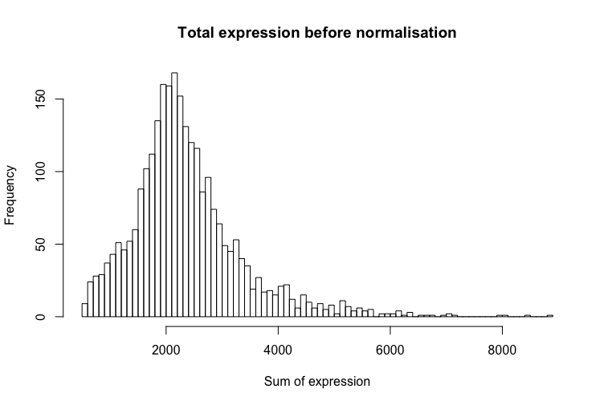
Normalizing gene expression in each cell
Why normalize gene expression within a cell?
cells are sequenced to different depths (technical)
cells of different type have different amounts of mRNA (biological)
there are typically extreme values in distribution of gene expression
more highly expressed genes are more variable

Slide 24
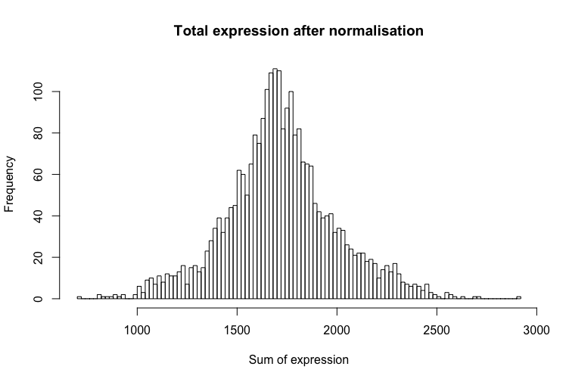
Normalizing gene expression in each cell
How to normalize
Gene expression measurements for each cell are normalized by the total gene expression or median gene expression
Gene expression values then scaled to sum to 10,000 (typically), and then log-transformed.

Slide 25
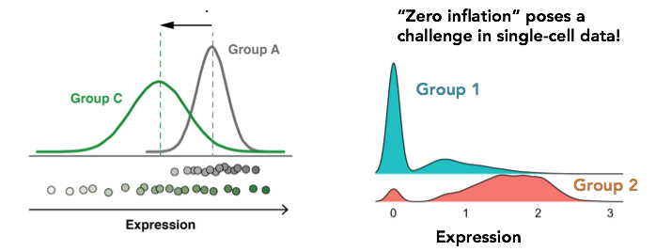
Is standard normalization appropriate?
Reassessing the idea that droplet scRNA-Seq is zero-inflated
“Droplet scRNA-seq is not zero-inflated.” Svensson, Nature Biotechnology (2020)
”Feature selection and dimension reduction for single-cell RNA-Seq based on a multinomial model.” Townes et al. Genome Biology (2019)
“Normalization and variance stabilization of single-cell RNA-seq data using regularized negative binomial regression.” Hafemeister et al. Genome Biology (2019)
Single
cell
Bulk

Slide 26
Is standard normalization appropriate?
Example of how current approaches to normalization and transformation artificially distort differences between zero and nonzero counts. a UMI count distribution for gene ENSG00000114391 in the monocytes biological replicates negative control dataset. b Counts per million (CPM) distribution for the exact same count data. c Distribution of log₂(1+CPM) values for the exact same count data
William Townes F. et al. Genome Biology (2019) 20: 295.

Slide 27
Determining cell type, state, and function
Quality control
Normalization
Feature selection
Dimensional reduction
Cell-cell distances
Unsupervised clustering
Kiselev C. at al. (2019) Nature Reviews Genetics. 20: 273-282.

Slide 28

Identify highly variable genes
Cells are in ~20,000 dimensional space (one dimension for each gene)
many genes are lowly detected or noisy measurements
variable genes contain the biological signal we are interested in

Slide 29
Identify highly variable genes
CV (counts)
Mean counts
Find genes (features) that are outliers in a plot of mean of gene expression vs variance of gene expression

Slide 30

Calculating gene signatures
Relying on capturing a specific gene is not robust, but relying on a set of genes (signature) is much more stable!

Slide 31
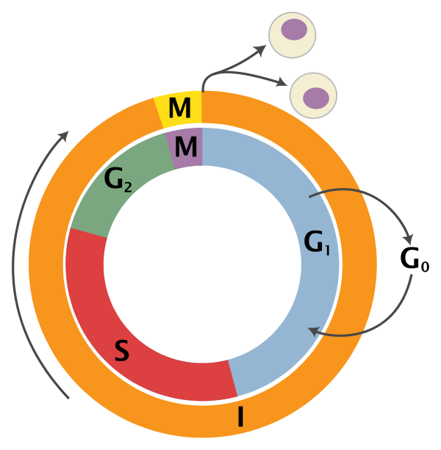
Gene signature example: cell cycle markers
variability of individual genes
cell cycle genes

